Slide 1
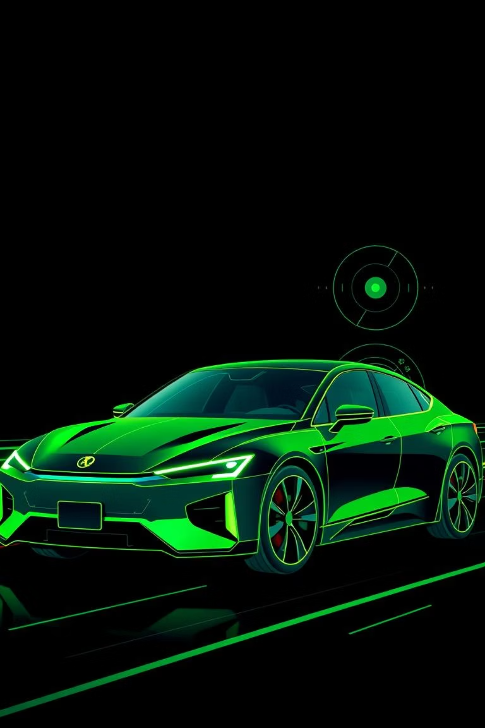
Advancing Automotive Safety: Rigorous AEB Testing
GROUP 5
Welcome to an in-depth look at our Autonomous Emergency Braking (AEB) system testing. This presentation outlines our comprehensive approach to ensuring AEB reliability and compliance, from diverse environmental scenarios to advanced simulation techniques and regulatory standards.
MENTOR : - ABHISHEK SIR

Slide 2
TEAM MEMBERS:
DEEPAK :Introduce AEB & Objective of the Test Plan
SUMA : Test Scenarios under Weather & Road Conditions
USHA : Test Scenarios: Speed-Based Situations
VIKASH : Sensor Fusion – Radar and Camera Accuracy
PRINCE : Virtual Testing Tools & Automation
JYOTISMAN : NCAP Compliance & Pass Criteria for AEB Systems

Slide 3
CHAPTER 1
Understanding AEB Fundamentals
What is AEB?
How Does it Work?
The Core Objective of Testing
AEB is a critical safety system designed to automatically apply brakes to prevent or mitigate collisions. It acts as an invaluable co-pilot, enhancing driver safety by responding faster than human reflexes in critical situations.
AEB systems utilize an array of sophisticated sensors, including cameras and radar, to continuously scan the environment. These sensors detect potential obstacles such as vehicles, pedestrians, or cyclists, processing data in real-time.
Our primary goal is to ensure AEB activates precisely when needed, under diverse, real-world driving conditions. This involves rigorous validation of its performance across varying environments, speeds, and complex scenarios, guaranteeing consistent and reliable operation.

Slide 4

CHAPTER 2
Environmental Resilience
Testing in Diverse Weather and Visibility Conditions
Testing AEB systems across a spectrum of environmental conditions is paramount to ensuring their reliability and effectiveness in real-world scenarios. Each condition presents unique challenges for sensor performance and system response:
Wet Roads: Introduce increased braking distances and the risk of hydroplaning, testing AEB's ability to maintain control and prevent skidding while ensuring timely stops.
Fog: Significantly impairs camera performance, making radar crucial for accurate obstacle detection and ranging. AEB must seamlessly transition reliance between sensors.
Snow: Affects both visibility and sensor accuracy, demanding robust algorithms to differentiate between snow, road, and obstacles, preventing false positives or missed detections.
Low Light/Night Driving: Critical for pedestrian and cyclist detection, requiring enhanced sensor sensitivity and advanced image processing to identify vulnerable road users in challenging lighting.

Slide 5
CHAPTER 3
Dynamic Speed Scenarios
Testing AEB Performance Across Speed Ranges
AEB system performance must be meticulously validated across the entire spectrum of driving speeds, from urban congestion to highway cruising. This ensures adaptive and accurate response tailored to the kinetic demands of each environment.
Low-Speed Urban Traffic
1
In congested city environments, AEB is tested for its ability to detect sudden stops, quickly braking vehicles, and vulnerable road users like pedestrians or cyclists appearing unexpectedly. The focus is on rapid, precise intervention to prevent fender-benders and protect pedestrians.
High-Speed Highway Scenarios
2
On highways, testing focuses on detecting slower vehicles ahead with sufficient lead time for braking, preventing high-speed rear-end collisions. Crucially, tests ensure the system avoids false braking triggered by overhead signs, bridges, or road furniture, maintaining smooth, safe operation.
Transition & Edge Cases
3
Beyond static speeds, AEB is rigorously tested during speed transitions, rapid acceleration/deceleration, and in complex multi-vehicle interactions to simulate real-world dynamic driving. This includes evaluating performance in cut-in/cut-out situations and sudden lane changes.

Slide 6

CHAPTER 4
The Power of Sensor Fusion
Camera Sensor
Sensor Limitations
Accurate Detection
Radar Sensor
Data Fusion
The synergy of camera and radar is fundamental to AEB's reliability. Cameras offer high-resolution imagery and color information, crucial for object classification, but are vulnerable to adverse weather. Radar provides robust detection in poor visibility, measuring distance and speed with precision, though with less detail. Sensor fusion combines these strengths, creating a comprehensive and resilient perception system that can make accurate braking decisions across all conditions.

Slide 7




CHAPTER 5
Tackling Sensor Fusion Challenges
While powerful, sensor fusion faces specific challenges that can impact AEB performance. Addressing these through meticulous testing and calibration is vital for system reliability and safety.
Sensor Misalignment
Dirty or Blocked Surfaces
Even slight physical displacement of sensors can lead to erroneous data integration, compromising the fused perception and potentially causing incorrect braking decisions.
Accumulated dirt, ice, or debris on sensor lenses or covers can obscure their view, degrading data quality and hindering accurate object detection, especially in adverse weather.
Environmental Interference
Fusion Algorithm Robustness
External factors like heavy rain, strong sunlight glare, or electromagnetic interference from other vehicles can disrupt sensor signals, leading to false readings or missed detections.
The complexity of fusing disparate data streams requires sophisticated algorithms to handle discrepancies, prioritize information, and maintain a consistent environmental model, crucial for reliable decision-making.

Slide 8
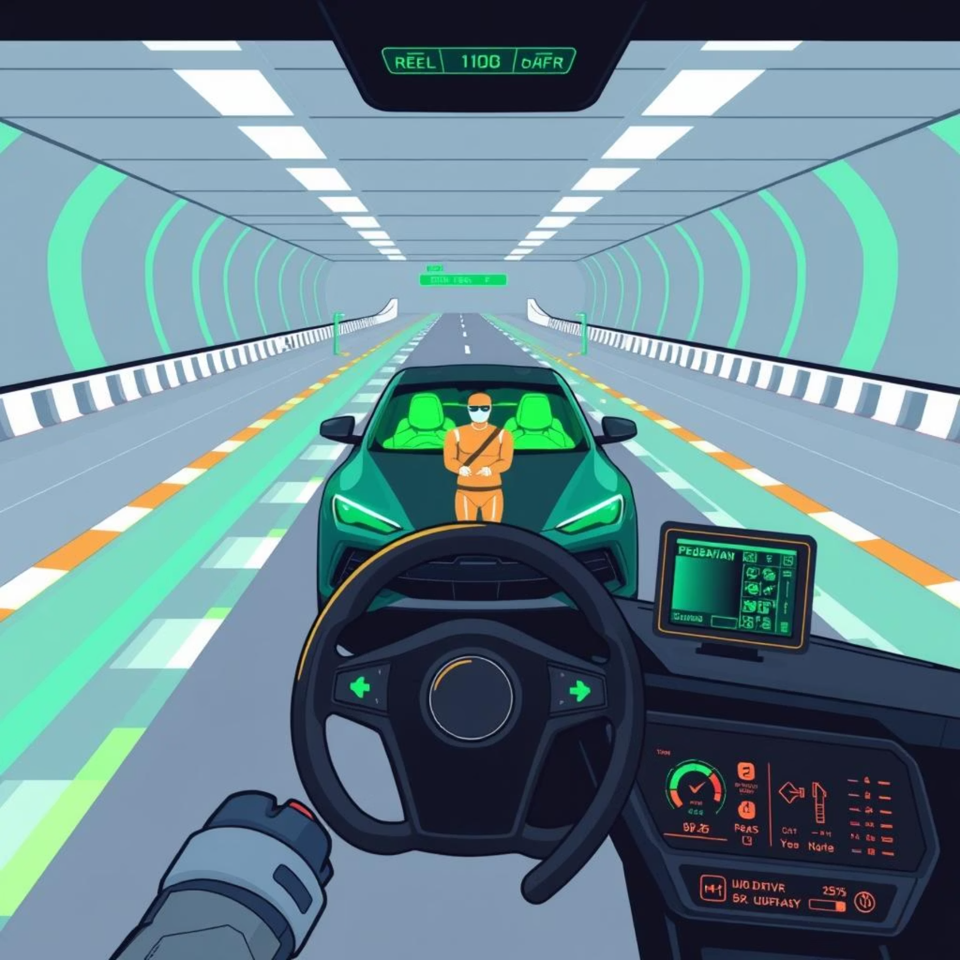
CHAPTER 6
Virtual Validation with Simulation
Simulating AEB Tests Using Virtual Environments
Virtual simulation tools are indispensable for developing and validating AEB systems. They provide a controlled, repeatable, and safe environment to conduct extensive testing before costly physical prototypes.
Advanced Simulation Tools: We leverage industry-leading platforms such as dSPACE, IPG CarMaker, and MATLAB/Simulink. These tools allow us to create highly realistic scenarios and precisely model system behavior.
Comprehensive Scenario Modeling: These environments enable us to simulate intricate weather and road conditions, diverse speed profiles, and granular sensor behaviors. This level of detail allows for testing corner cases that are difficult or dangerous to replicate physically.
Key Benefits:
Repeatability: Identical test cases can be run infinitely, ensuring consistent results and facilitating iterative design improvements.
Safety: Critical crash scenarios can be tested without risk to personnel or physical prototypes.
Cost & Time Efficiency: Significant reductions in development time and expense by identifying issues early in the design cycle, minimizing reliance on expensive physical testing.

Slide 9
CHAPTER 7
NCAP Compliance & Accreditation
Meeting regulatory and safety standards is non-negotiable. The Euro NCAP protocol sets the benchmark for AEB performance, demanding rigorous adherence to specific test criteria for top safety ratings.
Car-to-Car Rear Impact
1
Tests evaluate AEB's effectiveness in preventing or mitigating rear-end collisions with stationary, slower-moving, or braking lead vehicles at various speeds.
2
Pedestrian Crossing Scenarios
Simulates real-world pedestrian interactions, including adult and child dummies crossing in front of the vehicle, assessing AEB's detection and braking capabilities.
Night-time Operation
3
Specific tests address low-light and night driving conditions, ensuring AEB can reliably detect and react to vulnerable road users when visibility is severely compromised.
4
Cyclist Detection
Evaluates the system's ability to identify and react to cyclists, who present unique challenges due to their varied speeds, trajectories, and profiles compared to pedestrians or cars.

Slide 10




CHAPTER 8
AEB Performance Criteria
To achieve top safety ratings and ensure real-world effectiveness, our AEB system must consistently demonstrate proficiency across several critical performance metrics as defined by NCAP.
Accurate Object Detection
The system must reliably and precisely identify relevant objects (vehicles, pedestrians, cyclists) in complex environments, distinguishing them from benign obstacles or background clutter.
Timely Driver Warning
Before automatic braking, the system must provide clear, unambiguous visual and/or audible alerts to the driver, allowing for human intervention if appropriate.
Effective Brake Application
The system must apply brakes at the optimal moment and with appropriate force to either entirely avoid a collision or significantly reduce its severity, minimizing potential injury and damage.
Adherence to Scoring Criteria
Our AEB system is engineered to meet or exceed all stringent NCAP scoring criteria, ensuring compliance with the highest global safety standards and contributing to maximum vehicle safety ratings.

Slide 11
Key Takeaways & Next Steps
1
Comprehensive Testing
2
Sensor Fusion Validation
Our rigorous testing covers diverse conditions, from adverse weather to high-speed scenarios, ensuring AEB reliability across the operational design domain.
We prioritize the robust performance of sensor fusion (camera + radar) to overcome environmental challenges and deliver precise obstacle detection.
3
Virtual Simulation Efficiency
4
NCAP Compliance
Our commitment to meeting stringent NCAP standards guarantees our AEB system contributes to the highest levels of vehicle safety and consumer confidence.
Leveraging advanced simulation tools allows us to conduct extensive, repeatable, and safe tests, significantly reducing development time and costs.
These efforts ensure our AEB systems are not only cutting-edge but also reliably safeguard drivers and vulnerable road users. We will continue iterative testing and explore advanced AI integration for predictive braking.

